Slide 1
North Atlantic Ports Association (NAPA)
June 9, 2022

Slide 2
Agenda
Scorecard
Priority Berthing
Electrification
New Supply Chain Envoy
PIDP
Ocean Shipping Reform
FMC Initiatives
CBP
Buy American
Port Equipment
U.S. Competition Legislation
WRDA 2022

Slide 4
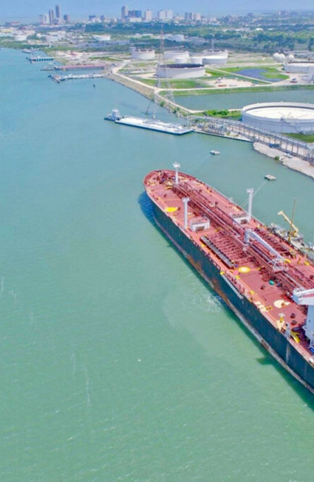
Priority Berthing
Rep Garamendi --> expected bill introduction this week (6.13)
Purpose: priority access for vessels/carriers intent on trade in exports; increase "access" for exporters
Mechanism: mandatory berth priority for vessels taking >75% capacity in exports; supposedly codifying existing practice for U.S. Flag/military
Posture: Major workability issues; others agree
Other Notes: Changing ops model of landlord ports; labor crew alignment; Commerce Clause; international law; other

Slide 5
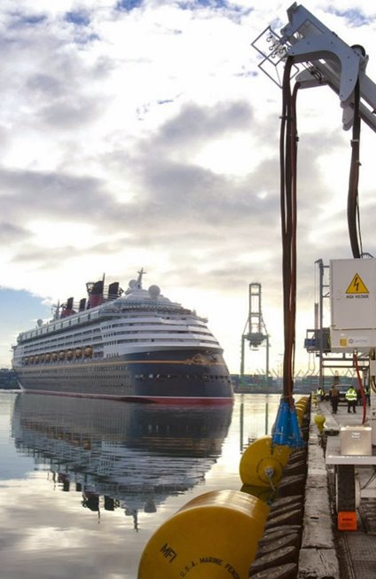
Electrification
Very hazy outlook on Port Electrification Program in 'Reconciliation.’ ($3.5B/5 yrs)
Clean Shipping Act of 2022 --> expected bill introduction this month
Set requirements to eliminate in-port ship emissions by 2030. By 2030, all ships at-berth or at-anchor in U.S. ports would emit zero GHG emissions/zero air pollutant emissions.
Progressive carbon intensity standards for fuels used by ships consistent with a 1.5-degree Celsius decarbonization pathway. These standards would require lifecycle carbon dioxide-equivalent reductions of 20% by 2026, 45% by 2030, 80% by 2035, and 100% by 2040 (based on a 2024 baseline).

Slide 6
New Supply Chain Envoy
Retired General Stephen R. Lyons, former Commander of the U.S. Transportation Command will serve as new White House Port Envoy
Meeting with AAPA June 7, 2022
Lyons will work with USDOT, the White House Economic Council, ports, rail, and private industry to improve shipping supply chains
Lyons: “I look forward to rolling up my sleeves and continuing to engage industry, labor, and port stakeholders to improve the fluidity of our supply chains, cut down on shipping costs, and ultimately save money for the American people.”

Slide 7
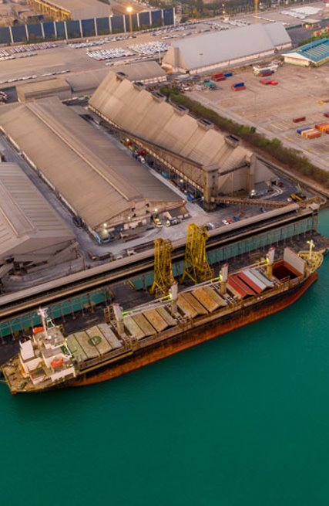
PIDP
Application window for $684 million FY2022 grants closed May 16 ($450 - IIJA, $234 million - regular appropriations)
$450 million will be available from the IIJA, plus regular appropriations from FY2023-2026.
AAPA requested full authorization for PIDP: $750 million in FY2023, with IIJA totals $1.2 billion in FY2023.
AAPA has submitted a memo to Congress asking for:
A $750 million appropriation in FY2023
An adjustment to index the size of awards to inflation
Proper implementation of a new NDAA provision
Allow MARAD to accept Federal Railroad Administration Categorical Exclusions to NEPA reviews

Slide 8
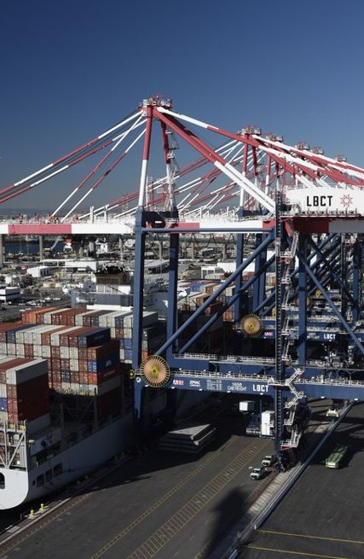
Ocean Shipping Reform
Hard-fought win for industry that Senate version will prevail. (Legislative details in attached memo.)
Still, lots of new requirements in terms of customer access and redress, per diems, billing, and data collection.
AAPA gearing up for fast turnaround on rulemaking at FMC re detention and demurrage.
Outstanding question what it means for extreme dwell fees.

Slide 9
FMC Initiatives
Preliminary rulemaking on detention and demurrage billing practices
Timing, minimum information, redress
Fact Finding 29: dual moves, ERDs, contract enforcement
Significant overlap with AAPA's Incent & Invest
FMC data initiative
Ports to maintain community systems; no report imminent

Slide 10
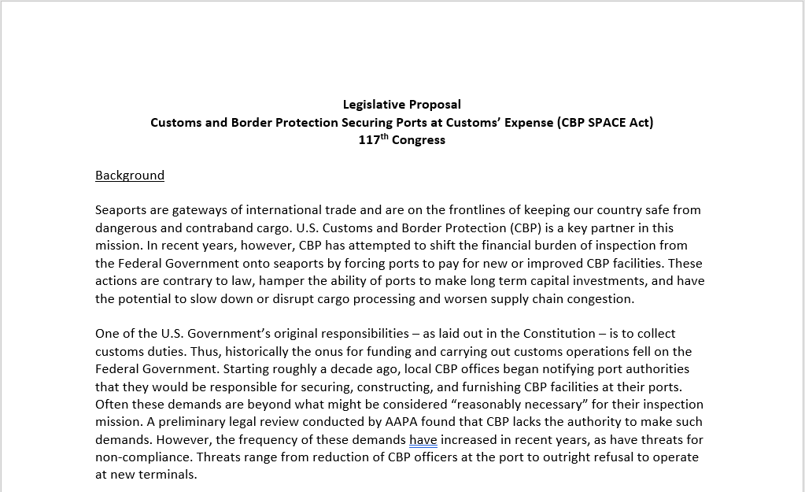
CBP
Legislative proposal (CBP SPACE Act) expanded from user fee redirection to include limiting scope of ‘Free Space’ agreements
Outreach to 10 key offices on Capitol Hill
All have expressed varying degrees of support – need champion to introduce.
Appropriations – Sen. Murray to push for tougher report language

Slide 11
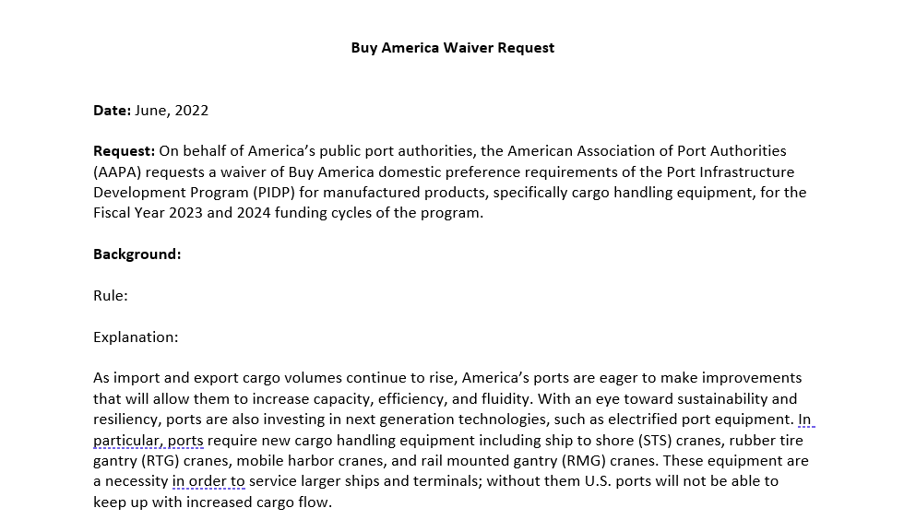
Buy American
Waiver issued for construction materials (wood, glass, metals other than iron/steel)
180-day waiver period starting 5/14/22
AAPA submitted supportive comments but explained the need for further waivers
Currently drafting an industry-wide waiver for iron, steel, and manufactured products
Filing will lay out legal and business case
To be sent to DOT, White House, other stakeholders

Slide 12
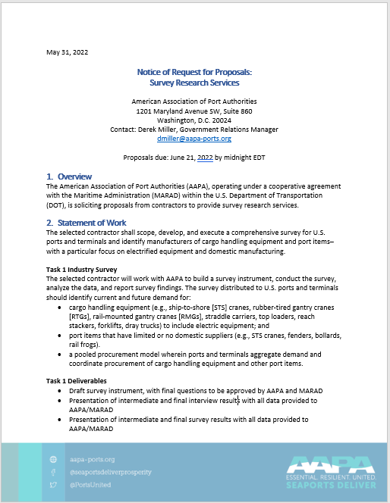
Port Equipment
RFP published 5/31 for consultant to conduct MARAD-funded comprehensive survey of port equipment needs
Results will be used to develop “order book” designed to entice U.S. manufacturers
Consultant will also explore options for pooled procurement of equipment
Outreach to manufacturing groups: Hollings Manufacturing Extension Partnership, Shipbuilders Council of America, Marine Manufacturers Association

Slide 13
U.S. Competition Legislation
Bills designed to boost U.S. competitiveness with China
AAPA sent letter of support for port-friendly provisions
Manufacturing Extension Partnership
Maritime apprenticeship program
Lowering trade barriers
Blocked amendment to ban Chinese port cranes
Bills are currently being negotiated by Conference Committee

Slide 14
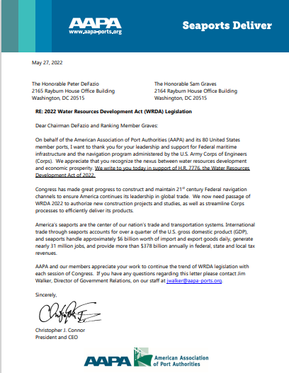
WRDA 2022
House passed H.R. 7776 on June 8.
Senate EPW Committee unanimously approved their version, S. 4137 on May 4. Full Senate consideration anticipated before August recess.
Key provisions:
H.R. 7776: Directs Corps to include current sea and weather conditions to coastal structure maintenance work
S. 4137: Directs Corps to not stop project construction while pursuing a Post-Authorization Change Request

Slide 15
Thank you!

